Slide 1




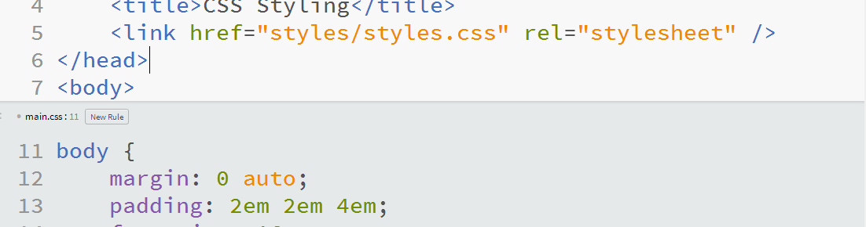
Web Fundamentals (HTML and CSS)
Course Introduction
Svetlin Nakov
Technical Trainer
www.nakov.com
Software University
http://softuni.bg

Slide 2


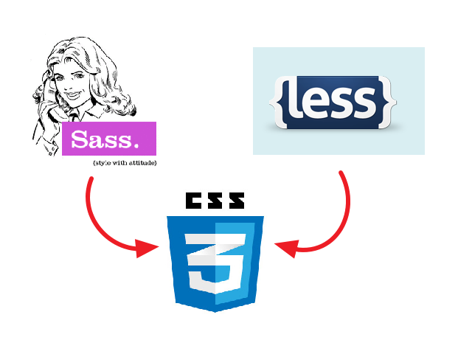

Table of Contents
Course Objectives
Course Program
Trainers Team
Examination
Learning Resources

Slide 3







SoftUni Diamond Partners

Slide 4
Level #1 at the Software University
Java Basics
4 times + TW + exam
3 weeks * 2 times
Web Fundamentals (HTML + CSS)
10 times + TW + exam
6 weeks * 2 times
JavaScript Basics
5 times + TW + exam
4 weeks * 2 times
PHP Basics
4 times + TW + exam
3 weeks * 2 times
Teamwork and Personal Skills
8 times + team work project (TW)
16 weeks * 0.5 times

Slide 5

Web Fundamentals (HTML + CSS)
Course Objectives & Program

Slide 6



Web Fundamentals – Course Topics
Web Technologies Basics. Web Development Tools
HTML Fundamentals
CSS Overview
HTML Tables
HTML Forms
Semantic HTML, Frames, Other Tags

Slide 7


Web Fundamentals – Course Topics (2)
CSS Presentation
CSS Layout
Responsive Design
Advanced CSS: CSS Preprocessors, Bootstrap, CSS Transitions
Team Work
Practical Exam

Slide 8

The Trainers Team

Slide 9
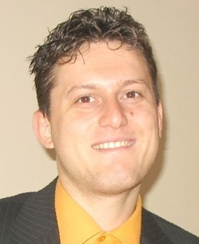
Trainers Team
Svetlin Nakov, PhD
Training & Inspiration Manager @ Software University
20+ years software development experience
10+ years experience as trainer
Author of 7 programming books
Speaker at hundreds of events
Web site & blog: www.nakov.com

Slide 10


Trainers Team (2)
Teodor Kurtev
Software engineer @ Software University
Top performing graduate from the Software Academy (2013)
Vladimir Georgiev
Software engineer @ Software University
Top performing graduate from the Software Academy (2013)

Slide 11
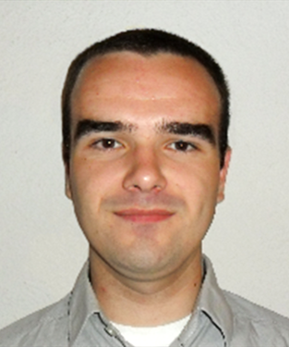

Trainers Team (2)
Vladislav Karamfilov
Game developer @ XS Software
Top performing graduate from the Software Academy (2013)
Volunteer Trainers
Top students from SoftUni
Will teach workshops and advanced topics

Slide 12

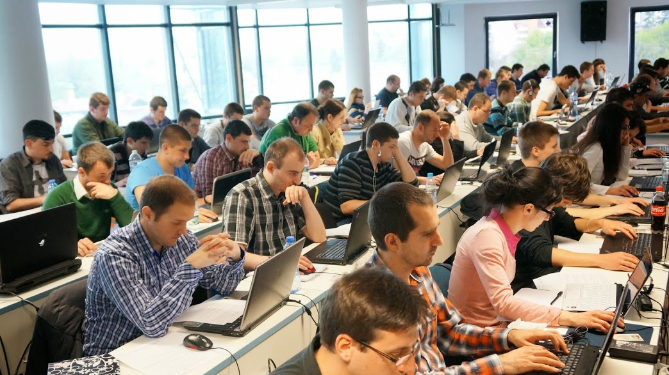
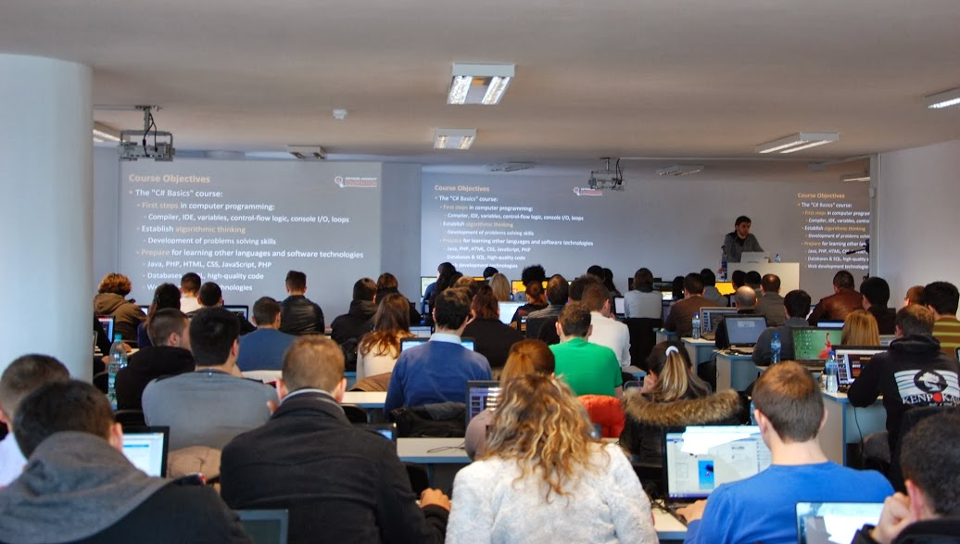
Volunteer Teaching Assistants
15+ volunteer teaching assistants
Developers from the software industry
Scholarship students from SoftUni

Slide 13

Web Fundamentals: More Details
Duration, Languages, Technologies

Slide 14


Training Duration – Web Fundamentals
Lectures: ~ 25 hours (onsite + YouTube videos)
Practical exercises (in class): ~ 15 hours
Homework: ~ 30-50 hours
Team project: ~ 10-20 hours
Exam preparation: 8 hours
Exam: 6 hours
Schedule: Sept – Oct 2014
Exam dates: 29 Oct, 2 Nov 2014

Slide 15
Why HTML & CSS?
HTML & CSS – standard for Web UI
Web-based application are very popular
Runs on any device with a Web browser
HTML5 is currently the #1 job trend based on the fastest growing keywords found in online job postings
HTML5 will get better and better and take bigger chunk of the mobile application market
Every IT professional should know HTML & CSS

Slide 16



Why English?
Why the slides are in English?
English is the native language of the software engineers
Specific terminology should be in English
Translations are inaccurate and funny
Just learn English!
No excuses

Slide 17
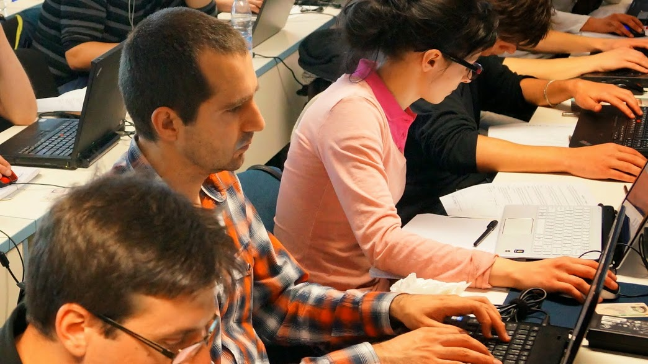


Web Fundamentals
Evaluation Criteria

Slide 18


Scoring System for the “Web Fundamentals”
Exam – 80%
Homework + evaluation – 5% + 5%
Team work: 10%
Presence in class: 5%
Bonuses: up to 10%
Assistant bonuses
Forum bonuses
Others

Slide 19
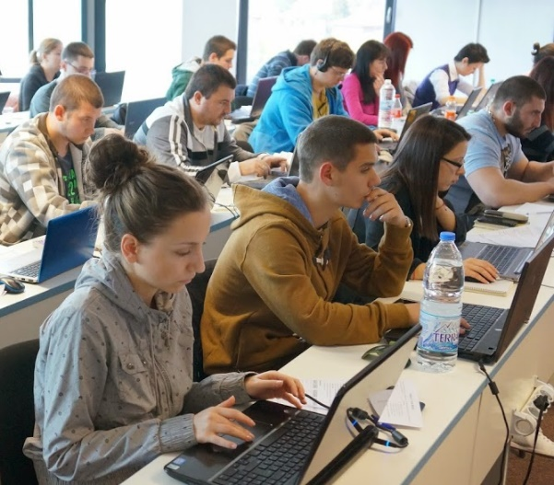
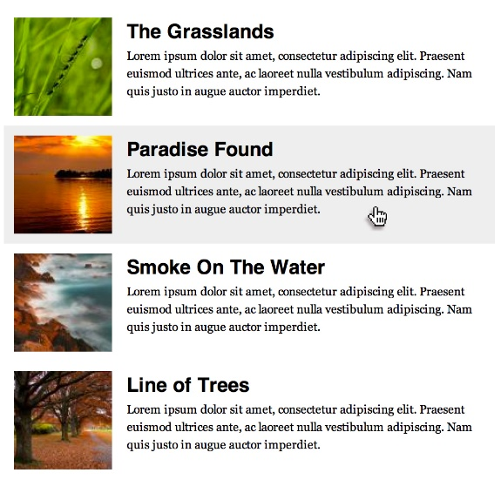



Web Fundamentals Exam
Practical HTML & CSS exam
You will be given a set of images
You should create the HTML & CSS
Sample exam problem:
+

Slide 20

Homework Assignments
Doing your homework is very important!
Programming can only be learned through a lot of practice!
You should write code every day!
Each lecture is followed by a few exercises
Try to solve them in class
The rest are your homework
Homework assignments are due in 2 weeks after each lecture
Submission will be accepted through our web site: softuni.bg

Slide 21

Homework Peer Reviews
Give feedback to a few random homework submissions
Students submit homework anonymously
Please exclude your name from the submissions!
For each homework submitted
Students evaluate 3 random homeworks
From the same topic, after the deadline
Give written feedback, at least 200 characters
Low-quality feedback → report for punishment
Everyone will get feedback for their homework

Slide 22









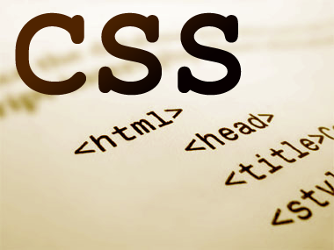
Resources
What We Need Additionally?

Slide 23

Course Web Site & Forums
The Web Fundamentals official web site:
Register for the "Software University Forum":
Discuss the course exercises with your colleagues
Find solutions for all course exercises
Share source code / discuss ideas / help each other
https://softuni.bg/trainings/coursesinstances/details/1065
https://softuni.bg/forum

Slide 24



Slides and Videos
All lecture slides, videos, homework assignments, projects and other resources are open content, available for free
Visit the course web site to access the course resources

Slide 25

HTML & CSS Tutorials
HTML & CSS @ Codecademy
http://www.codecademy.com/tracks/web
W3School HTML Tutorial
http://www.w3schools.com/html/
Learn to Code HTML & CSS
http://learn.shayhowe.com/html-css/
CSS Tricks
http://css-tricks.com

Slide 26
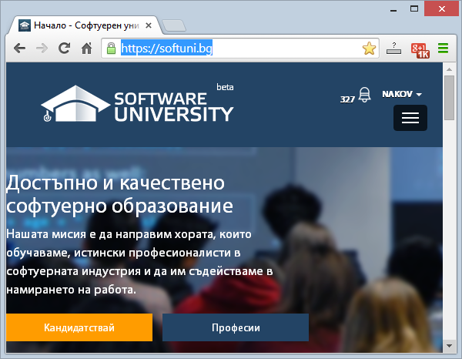
Software University Learning System (SULS)
Software University Learning System (SULS)
www.softuni.bg
Important resource for students
Homework submissions
Homework check-up
Exams and results
Reports about your progress
…

Slide 27


Recommended Software
You will need a text editor, e.g.
Notepad++
You may try many HTML authoring tools like:
Sublime Text
Brackets
Aptana Studio
Microsoft Visual Studio
Netbeans

Slide 28


Summary
The "Web Fundamentals" course teaches
The first steps in HTML & CSS
Training program
HTML, Tags, Tables, Forms, Semantic HTML, CSS, Styles, Positioning, Layout, Responsive
Practical exam
Form image to HTML & CSS + score system
Learning resources
Lectures, videos, software, books, forum
HTML & CSS

Slide 29
Web Fundamentals (HTML and CSS)
https://softuni.bg/courses/web-fundamentals/

Slide 30
License
This course (slides, examples, demos, videos, homework, etc.) is licensed under the "Creative Commons Attribution-NonCommercial-ShareAlike 4.0 International" license
Attribution: this work may contain portions from
"HTML Basics" course by Telerik Academy under CC-BY-NC-SA license
"CSS Styling" course by Telerik Academy under CC-BY-NC-SA license

Slide 31




Free Trainings @ Software University
Software University Foundation – softuni.org
Software University – High-Quality Education, Profession and Job for Software Developers
softuni.bg
Software University @ Facebook
facebook.com/SoftwareUniversity
Software University @ YouTube
youtube.com/SoftwareUniversity
Software University Forums – forum.softuni.bg

